Slide 1
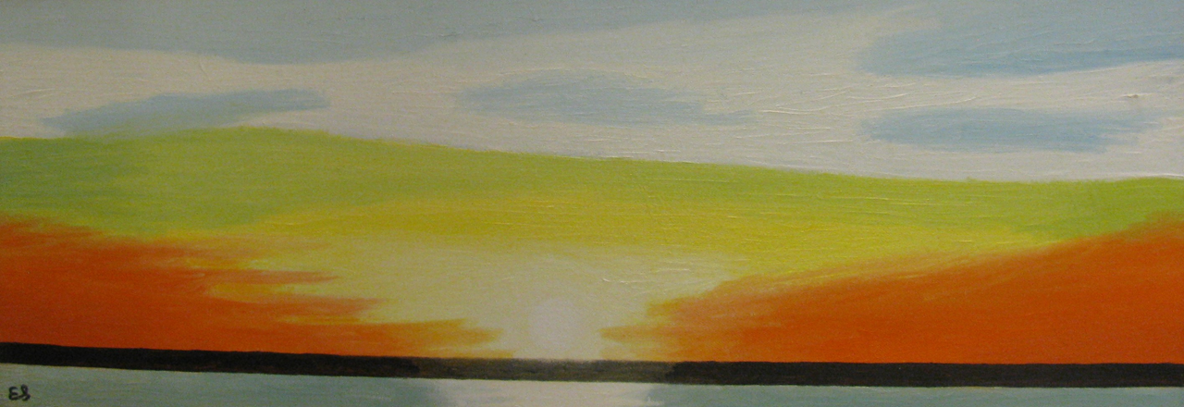
Permanent Collection Lesson Plan
Visual Art and Science
with Emilio Sanchez’s Hudson River Sunset
By Laney Buras
VIAR 216: Art in Education, Fall 2020
Professor: Dr. Claire Schultz
University of Louisiana at Lafayette

Slide 2
Brief Lesson Description/ Overview:
This project allows children to explore the beauty of the sun cycle by discussing Emilio Sanchez’s painting of a sunset.
This project aims at aiding students in becoming more accustomed to working with watercolor as their choice of media, while also further educating children about the sky’s appearance regarding the position of the sun.
This project also requires the children to consider several factors that can change the appearance of a sunrise or sunset, such as the weather, the location of the sunrise or sunset, and the time of year during which the sunrise or sunset is taking place.
This lesson plan takes inspiration from the artwork Hudson River Sunset, by Emilio Sanchez, which portrays a gorgeous sunset as it would appear over the Hudson River. This image can be found in the Permanent Collection of the Hilliard Art Museum on their website.

Slide 3
Grade Level (Range):
Late Elementary School. 4th-5th. Requires knowledge of the sun cycle and the skill of being able to use watercolor and other media, such as marker or crayon, efficiently.
Integrated Content Area(s):
Science- Images of a sunrise or sunset. Knowledge about the sun cycle and other factors, such as weather or biological or physical features that can appear outside along with the student’s desired sunrise or sunset location.
Objectives:
Visual Arts: Students will learn to translate their own experiences of witnessing sunrises or sunset into an original watercolor painting.
Science: Students will gain a deeper understanding of the sun cycle and how factors, such as weather or biological or physical features, can change the appearance of the sky during a sunrise or sunset.

Slide 4
Big Idea:
Students will not only get to express their own unique interpretation of a sunrise or sunset, but they will also acquire a deeper understanding of how various factors, such as weather or the time of day, can affect the appearance of the sky and our world in general. Furthermore, students will become more proficient at working with various art media (in the case of this project, primarily watercolor).
Questions:
How are the colors that you have chosen related in a color scheme? (warm colors, cool colors, primary colors, etc.)
What is the foreground of your image? What is the background of your image?
Why did you choose this media to add details to elements found around or in front of your sunrise or sunset? (buildings, animals, physical features, vegetation, etc.)

Slide 5
Definitions
Color- the element of art that describes the phenomenon of light striking an object and reflecting to our eyes. This element consists of hues, intensity, and value.
Color Scheme- how various colors are related to each other on the color wheel
Foreground- objects that appear closest to the viewer in an image
Background- objects that appear farthest from the viewer in an image

Slide 6
Emilio Sanchez (Cuban-American, 1921–1999)
Hudson River Sunset, c.1980s
Oil of canvas
H-11 W-30 inches
Gift of the Emilio Sanchez Foundation
Catalog Number: 2011.08.02

Slide 7
Historical Context/Connections
Emilio Sanchez, born in 1922, was a Cuban-American artist who was made famous through his well known architectural paintings and his graphic lithographs. Sanchez was fascinated with the idea of how light and shadow played with various shapes of the buildings or objects that he painted, and this fascination is evident when viewing the majority of his work. Later in his life, Sanchez began experiencing issues with his eyesight and even became partially blind in one eye, but this did not stop him from continuing his love of painting. He passed away in 1999.

Slide 8
Art Concepts and Medium
The usage of watercolor will allow students to see how the colors of the sky during a sunrise or sunset all seem to merge seamlessly from one color to the next.
The usage of various media (preferably dark sharpie marker, dark crayons, or dark markers) will help students to see how various objects placed in front or on the side of a sunrise or sunset can stand out in a dark contrast to the sky itself.
This project will delve into many of the elements of art, such as color and perspective.

Slide 9
Materials List
Sheets of watercolor paper (teacher’s choice of size)
Watercolor paint brushes
Watercolor paint
Other media (preferably black Sharpie markers, darker crayons, or darker markers)

Slide 10
Day 1
Introduce the project and Emilio Sanchez’s Hudson River Sunset to the class.
Allow the students to experiment with various color schemes that they can use in order to create artwork.
Inform them that they must have a color scheme, location, weather conditions, and time of day (sunrise or sunset) chosen by the end of the class period/day.

Slide 11
Day 2
Supply each student with a sheet of watercolor paper, watercolor paint brushes, and the student’s choice of watercolor shade that align with their chosen color palette.
Allow the students to create the sky for their sunrise or sunset.
Ask the students questions about certain objects, animals, or physical features that could be found at their sunrise or sunset given the setting and time of day or night that coincide with their sunrise or sunset. This discussion will help aid the children in adding details to their painting the next day.

Slide 12
Day 3
Supply your students with their chosen media (preferably Sharpie marker, darker crayon, or darker marker).
Allow your students to add the final details to their paintings, including but not limited to animals, buildings, physical features, or objects found in the sky (clouds, stars, planes, etc.)

Slide 13
Day 4
Once your students have completed their painting, ask each student to give a brief description of their painting and why they chose to execute their painting in this way.

Slide 14
Extra! Extra!
The following slides can be used as a visual aid for the students to gather a better understanding of what their sunrise or sunset could look like as they complete the several steps spread out over a 4 day period.
Each slide shows what will be the expected as the end result. Days 1 and 4 will not be included as the students will not be adding any visual elements to their project on these days.

Slide 15
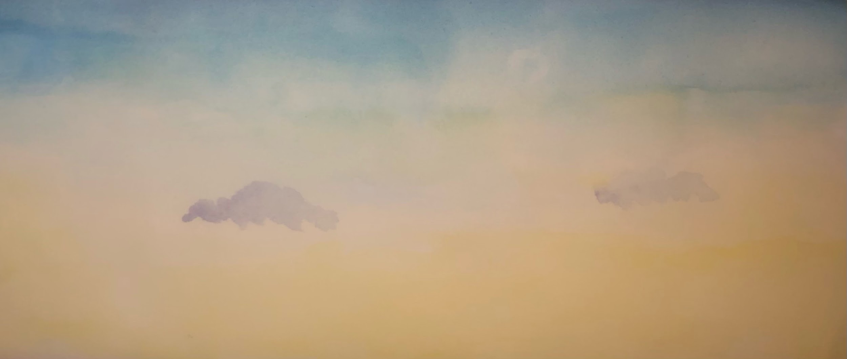
Day 2

Slide 16
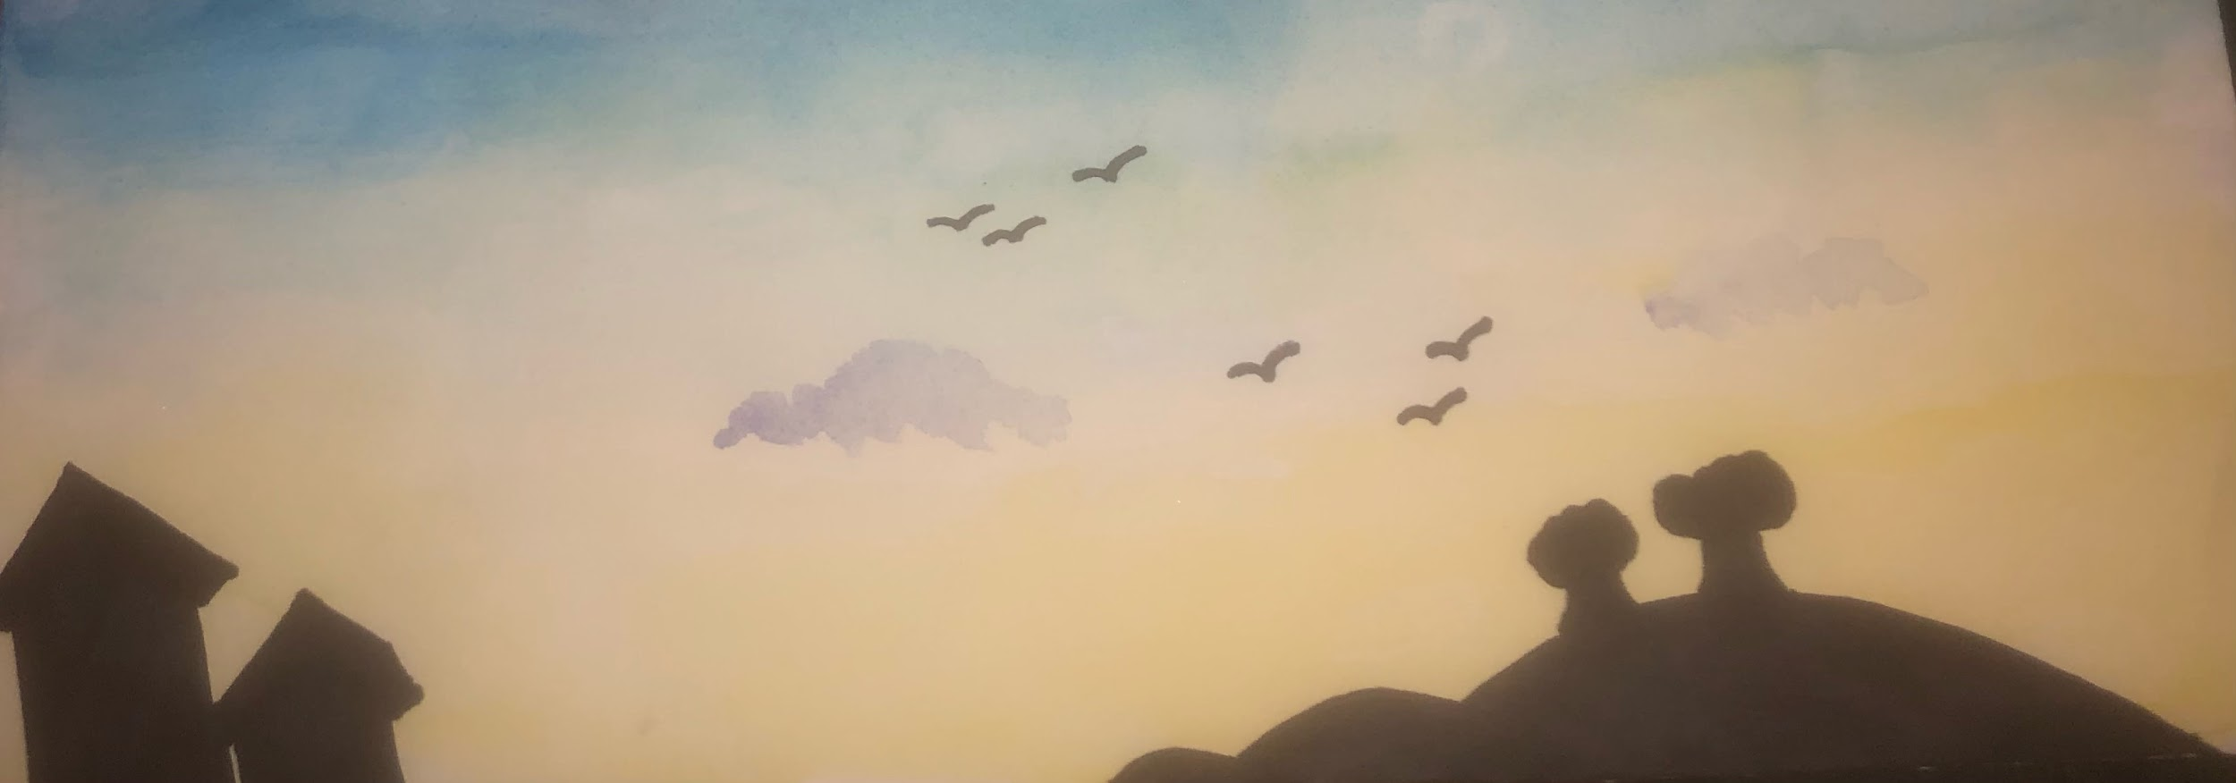
Day 3

Slide 17
Rubric
Objective | Exceeds | Meets | Does Not Meet
Studio, Visual Art Based | Unique choice of color scheme that still fits with the requirements of the project Many unique visual elements are used to enhance the setting and appearance of the painting | Predictable but acceptable color scheme Colors and objects may not appear to be neat, but make sense with the given setting that the student has chosen Only some visual elements are used to enhance the setting and appearance of the painting | Color scheme that does not have a conceivable connection (not all warm colors, not all cool colors, not all primary colors, etc.) Painting appears to be not neat and rushed Very little to no visual elements are used to enhance the setting and appearance of the painting
Interdisciplinary Subject Matter (math, science, ELA) | Elements used in the painting make sense scientifically in the chosen setting and the student has used an abundance of these elements in a creative manner | Elements used in the painting make sense scientifically in the chosen setting | Elements used in the painting do not make sense scientifically in the chosen setting (stars in the sky during a sunrise, an abundance of vegetation even though the sunrise or sunset takes place in Antarctica, etc.)

